Slide 1

Ethics and AI
Introduction to Machine Learning Balázs Nagy, PhD

Slide 2
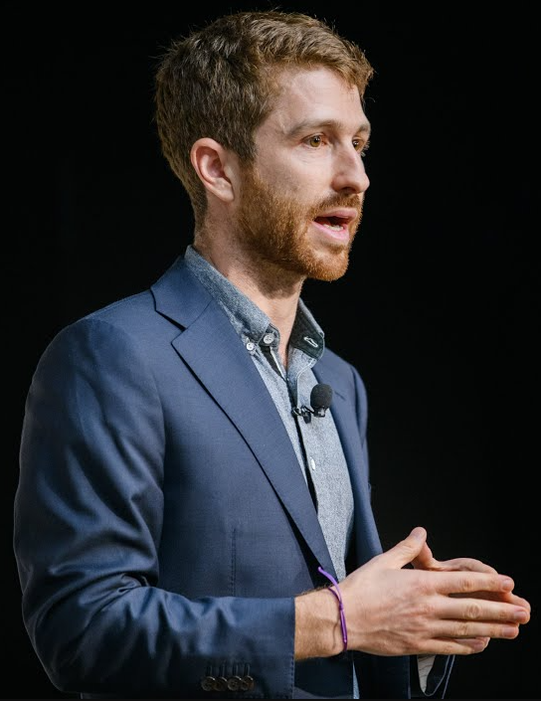
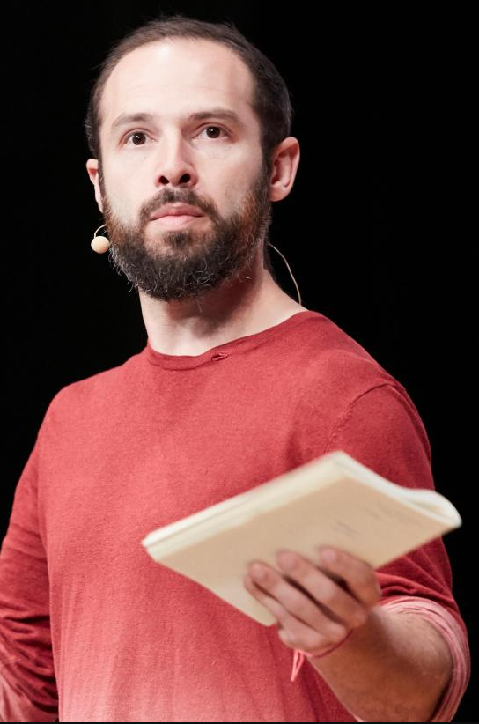

Mindset
Tristan
Harris
Aza Raskin
Our mission is to shift technology towards a more humane future that supports our well-being, democratic functioning, and shared information environment.
Notes:
Rubber band effect
Tristan Harris - technology ethicist - executive director and co-founder of the Center for Humane Technology
Aza Raskin
co-founder of the Center for Humane Technology
Earth Species Project

Slide 3
The AI dilemma
Tristan
Harris
Aza Raskin
Rubber Band Effect
If you pull it too far it will snap back
Notes:
Rubber band effect
Tristan Harris - technology ethicist - executive director and co-founder of the Center for Humane Technology
Aza Raskin
- co-founder of the Center for Humane Technology

Slide 4
The AI dilemma
References:
The AI dilemma speech
https://www.youtube.com/watch?v=cB0_-qKbal4&t=1163s
https://www.youtube.com/watch?v=xoVJKj8lcNQ&t=203s
Art Video featured in the speech
https://www.youtube.com/watch?v=uG8vItscFKc

Slide 5
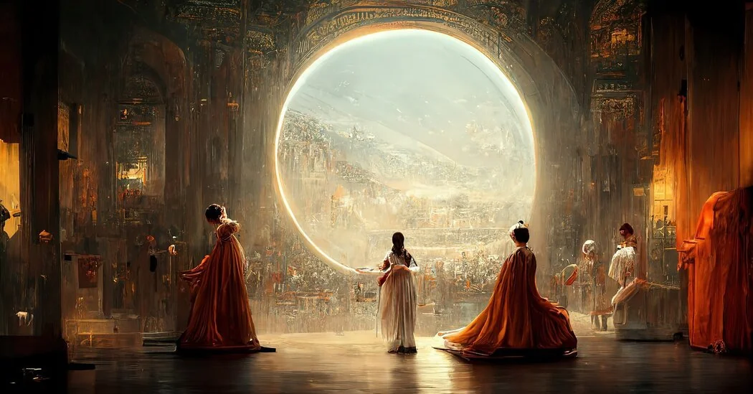
Théâtre D'opéra Spatial - Allen Jason (2022)

Slide 6
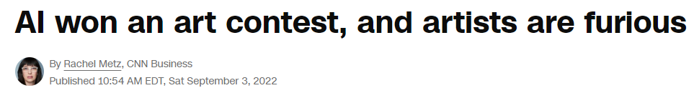
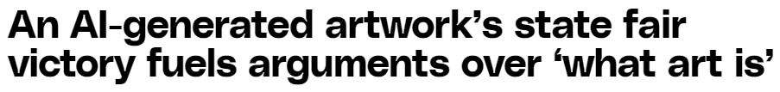
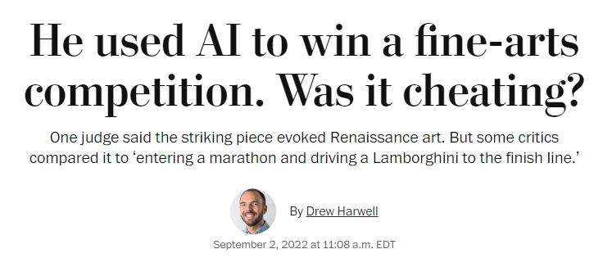
How should we treat AI?

Slide 7
How should we treat AI?
AI taking over our jobs?
Tool or Competition?

Slide 8

Two sides of AI
Helping
Tool
Fierce
Rival
OR
„We can achieve great things with it.”
„AI take our jobs.”
Notes:
A painter can use a brush to create a picture.
A digital artist use a generative model to create an image.
What is the difference? Is there any?
Prompt engineering.

Slide 9
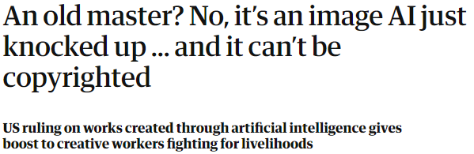
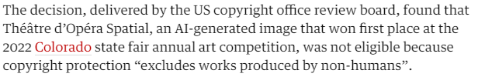
Closure?
https://www.theguardian.com/technology/2023/sep/24/an-old-master-no-its-an-image-ai-just-knocked-up-and-it-cant-be-copyrighted?fbclid=IwAR0XaFtPaDvqG-IsjVal_XuxjR5qXiRN_hIHreusy2LTL_kqtizwGlg24-Q

Slide 10
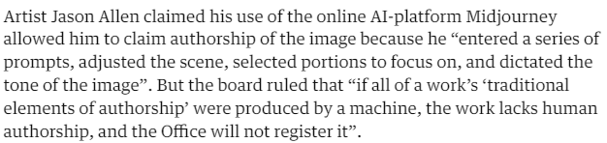
Closure?
https://www.theguardian.com/technology/2023/sep/24/an-old-master-no-its-an-image-ai-just-knocked-up-and-it-cant-be-copyrighted?fbclid=IwAR0XaFtPaDvqG-IsjVal_XuxjR5qXiRN_hIHreusy2LTL_kqtizwGlg24-Q

Slide 11
Closure?
https://www.theguardian.com/technology/2023/sep/24/an-old-master-no-its-an-image-ai-just-knocked-up-and-it-cant-be-copyrighted?fbclid=IwAR0XaFtPaDvqG-IsjVal_XuxjR5qXiRN_hIHreusy2LTL_kqtizwGlg24-Q

Slide 12
Attempt #1
Prompt: A big red fire breathing dragon flying over a ruined castle on a cliff overlooking the sea, with a stormy sky and crashing waves, eerie, moody, atmospheric Software: SD online Iteration: 2

Slide 13
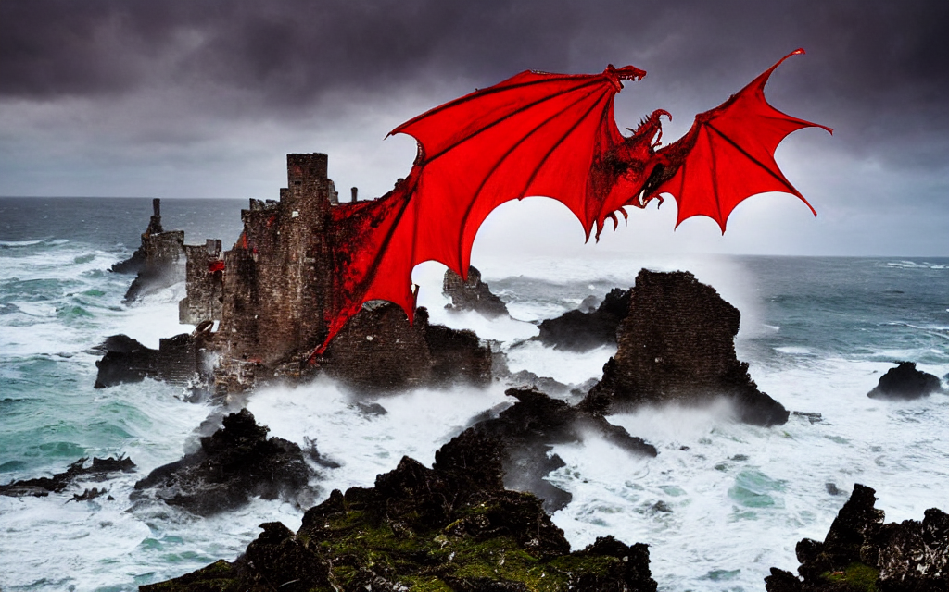
Attempt #1
Prompt: A big red fire breathing dragon flying over a ruined castle on a cliff overlooking the sea, with a stormy sky and crashing waves, eerie, moody, atmospheric Software: SD online Iteration: 2

Slide 14

Attempt #1
Prompt: A big red fire breathing dragon flying over a ruined castle on a cliff overlooking the sea, with a stormy sky and crashing waves, eerie, moody, atmospheric Software: SD online Iteration: 2

Slide 15
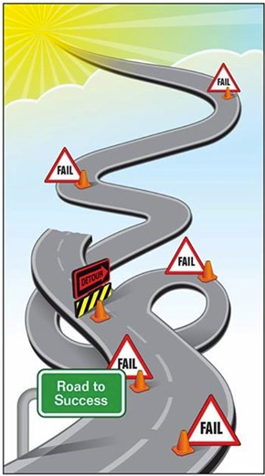
Road to success

Slide 16
Attempt # many
Prompt: Acrylic painting of a mountain landscape, with a stormy sky and a cabin nestled in the forest, high contrast, high resolution Software: SD offline Iteration: 40 Batch: 4

Slide 17
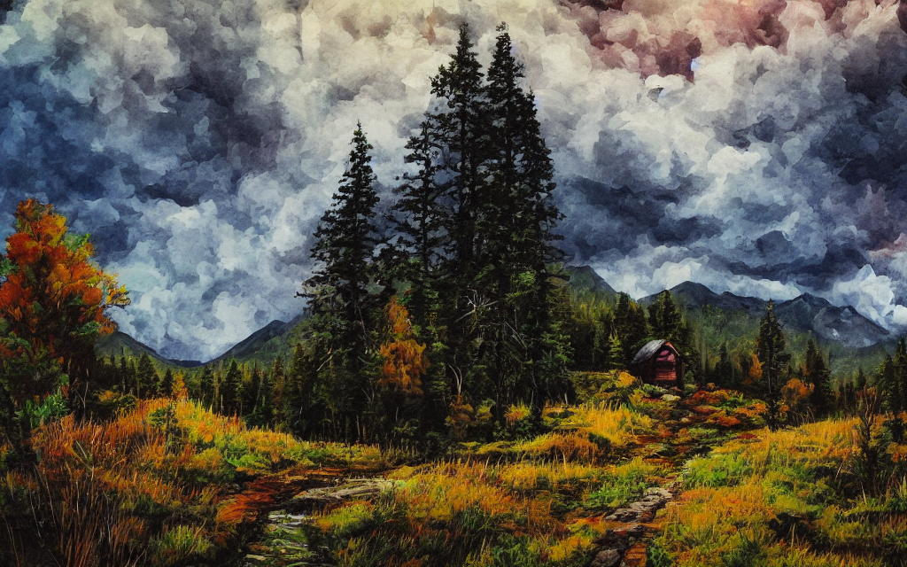
Attempt # many
Prompt: Acrylic painting of a mountain landscape, with a stormy sky and a cabin nestled in the forest, high contrast, high resolution Software: SD offline Iteration: 40 Batch: 4

Slide 18

Attempt # many
Prompt: Acrylic painting of a mountain landscape, with a stormy sky and a cabin nestled in the forest, high contrast, high resolution Software: SD offline Iteration: 40 Batch: 4

Slide 19
Previous Contest:
Majestic Creature

Slide 20
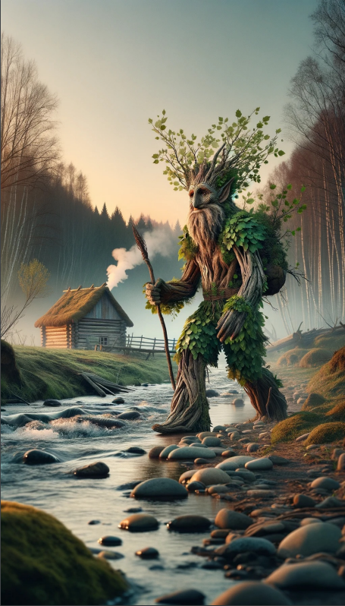
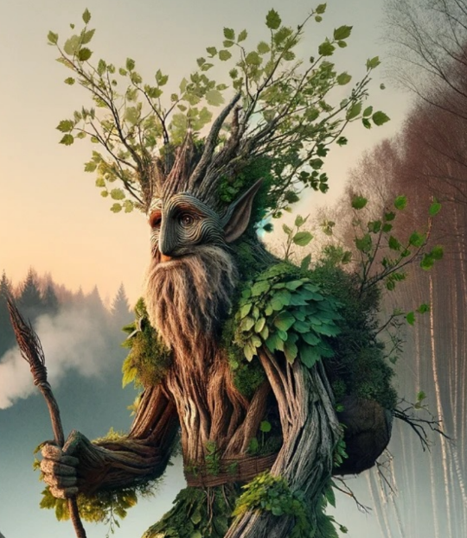
Creator:
Mihalkó Norbert Ádám
AI: DALL-E3

Slide 21
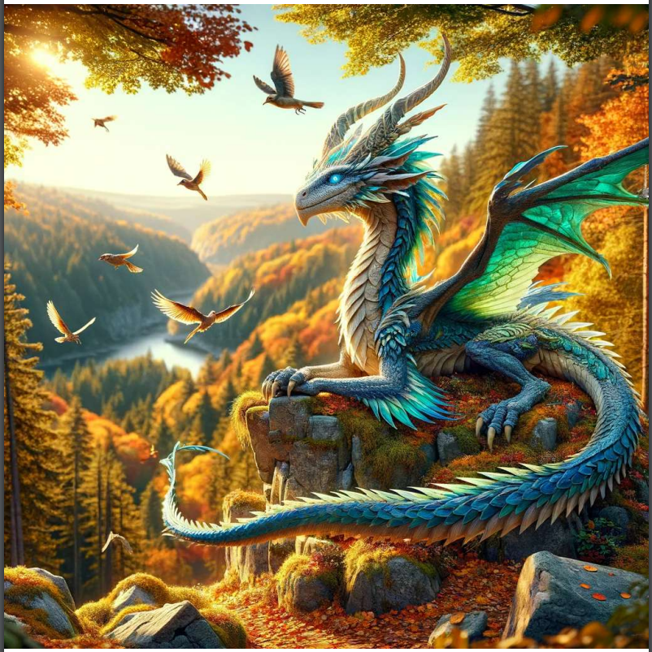
Creator:
Saglam Kadir
AI:
ChatGPT 4

Slide 22
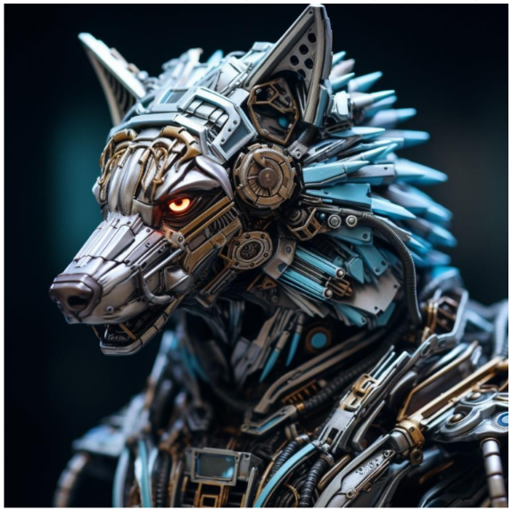
Creator:
Szigeti Péter
AI:
Midjourney

Slide 23
Previous Contest:
Unseen places

Slide 24
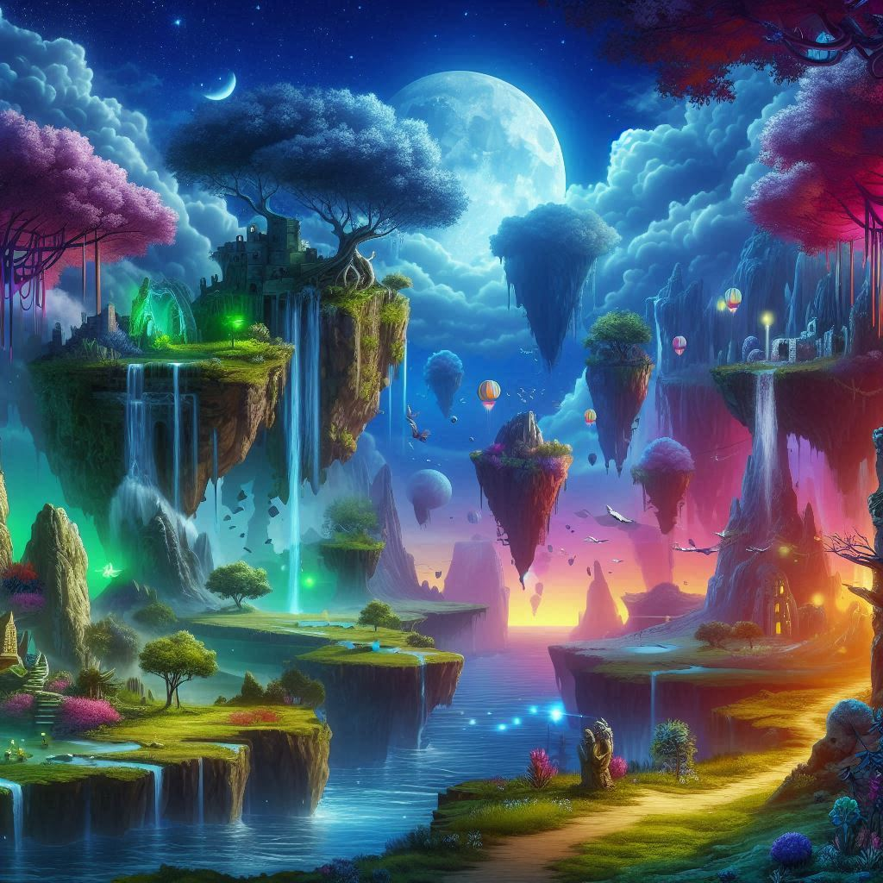
Unseen places
Artist: Lányi Csilla Anna
AI tool: Bing Copilot

Slide 25
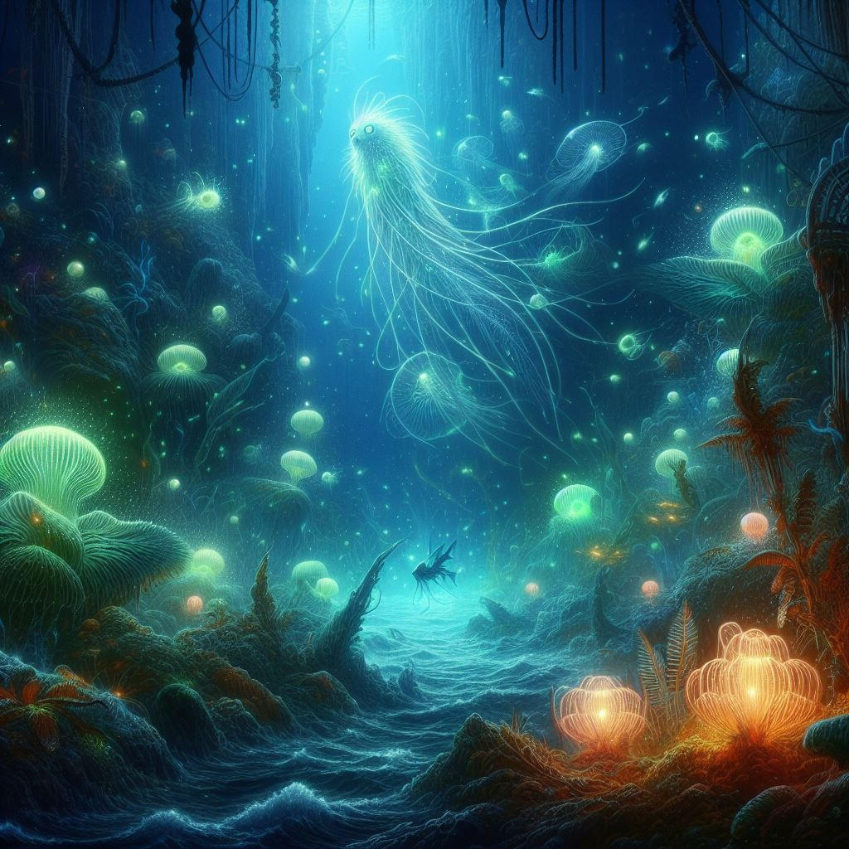
Unseen places In the depths of the ocean
Artist: Lányi Csilla Anna
AI tool: Bing Copilot

Slide 26

Unseen places In the depths of the ocean With marks, memories, ruins of an ancient culture
Artist: Lányi Csilla Anna
AI tool: Bing Copilot

Slide 27
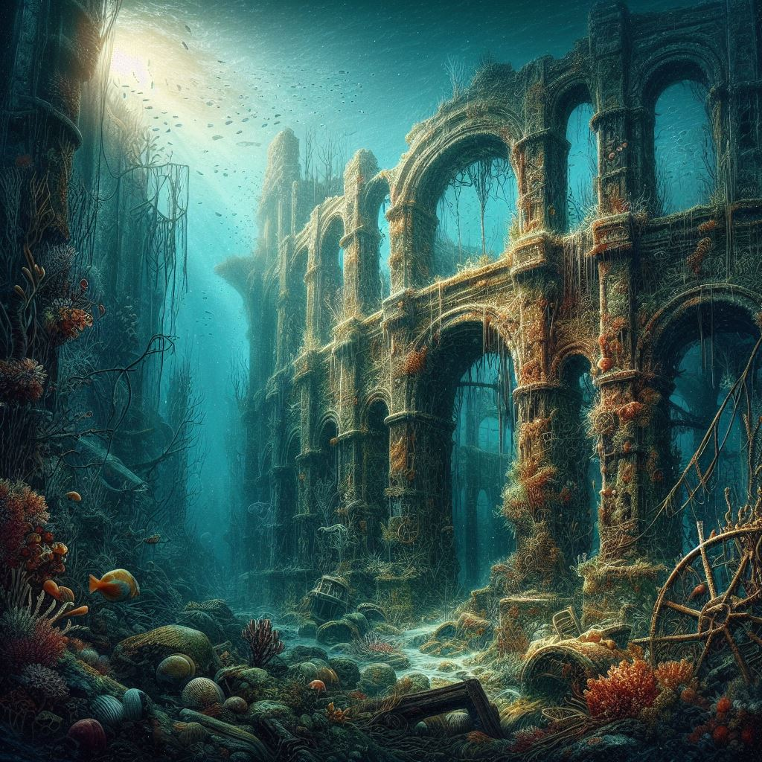
Unseen places In the depths of the ocean With marks, memories, ruins of an ancient culture Older, more ruined, almost part of the surrounding nature
Artist: Lányi Csilla Anna
AI tool: Bing Copilot

Slide 28
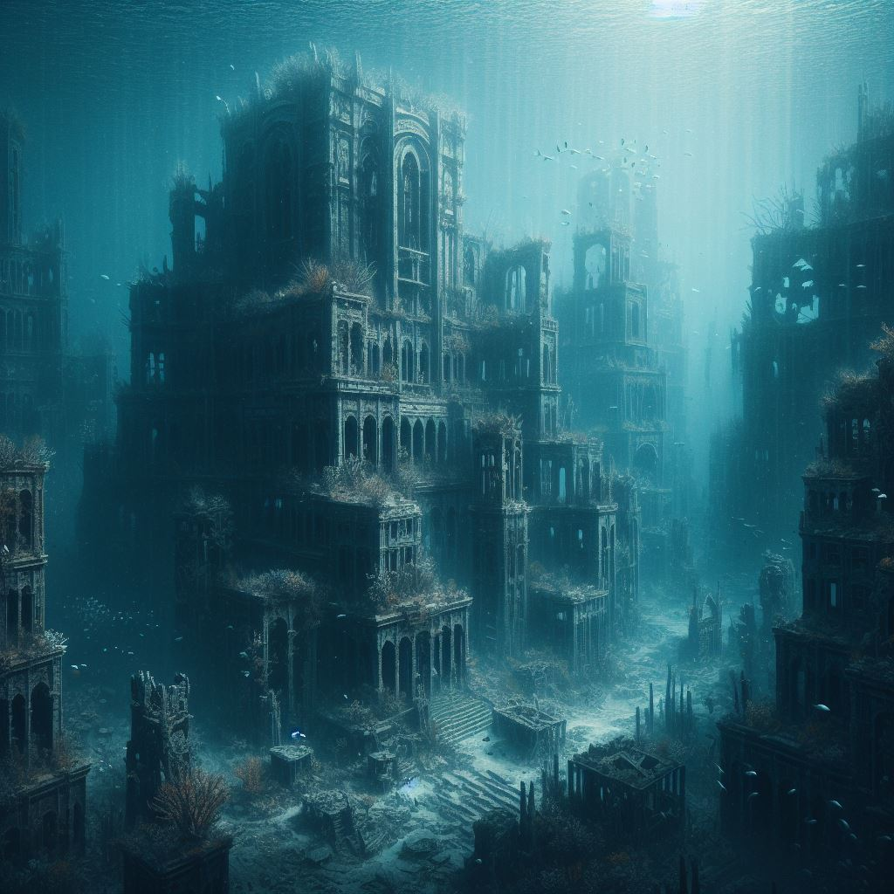
Unseen places In the depths of the ocean With marks, memories, ruins of an ancient culture Older, more ruined, almost part of the surrounding nature Marks of a tragedy, war, or natural catastrophe
Artist: Lányi Csilla Anna
AI tool: Bing Copilot

Slide 29
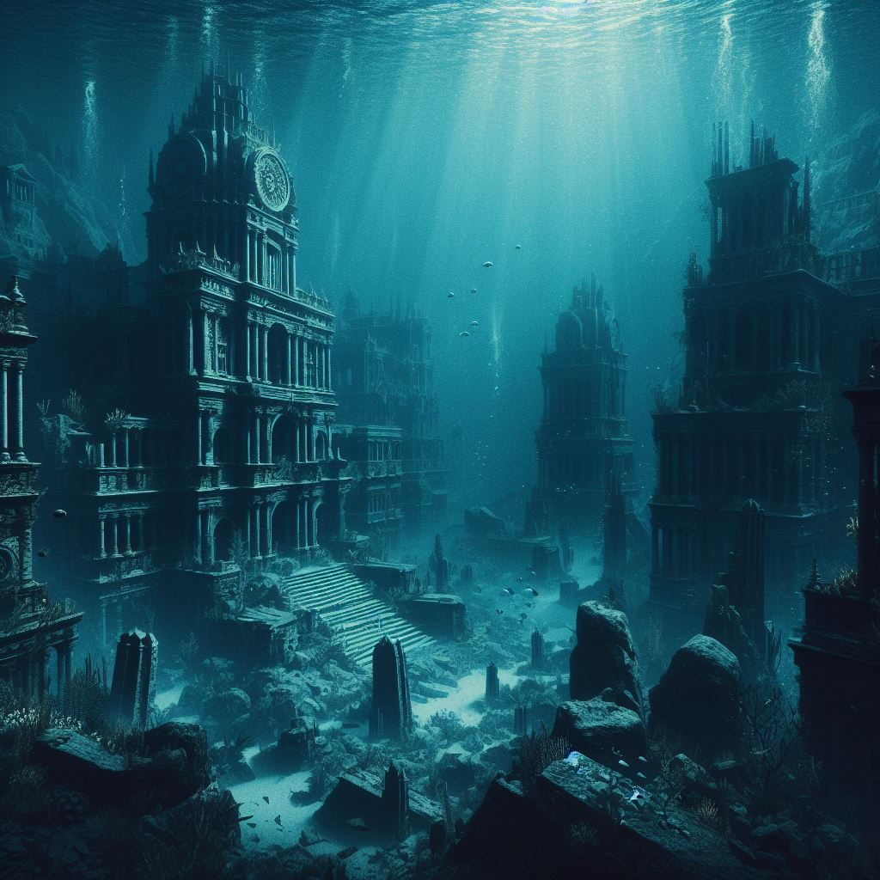
Unseen places In the depths of the ocean With marks, memories, ruins of an ancient culture Older, more ruined, almost part of the surrounding nature Marks of a tragedy, war, or natural catastrophe Darker and more mysterious (Final Image)
Artist: Lányi Csilla Anna
AI tool: Bing Copilot

Slide 30

Homework #1 (10 points)
Generative Art Competition
Generate a picture with a generative AI
Topic:
„Emotions”
Document the used software or application and the steps that lead to the final image
Include the used prompt
10 p
9 p
8 p

Slide 31
Homework #1 (10 points)
Generative Art Competition
Generate a picture with a generative AI
Topic:
„Emotions”
Document the used software or application and the steps that lead to the final image
Include the used prompt
Option 1: Dall-E https://openai.com/dall-e-2
Option 2: Stable Diffusion XL online https://clipdrop.co/stable-diffusion
Option 3: Stable Diffusion XL offline https://github.com/AbdBarho/stable-diffusion-webui-docker
Option 4: Midjourney
Option 5: Any other Generative model
10 p
9 p
8 p

Slide 32
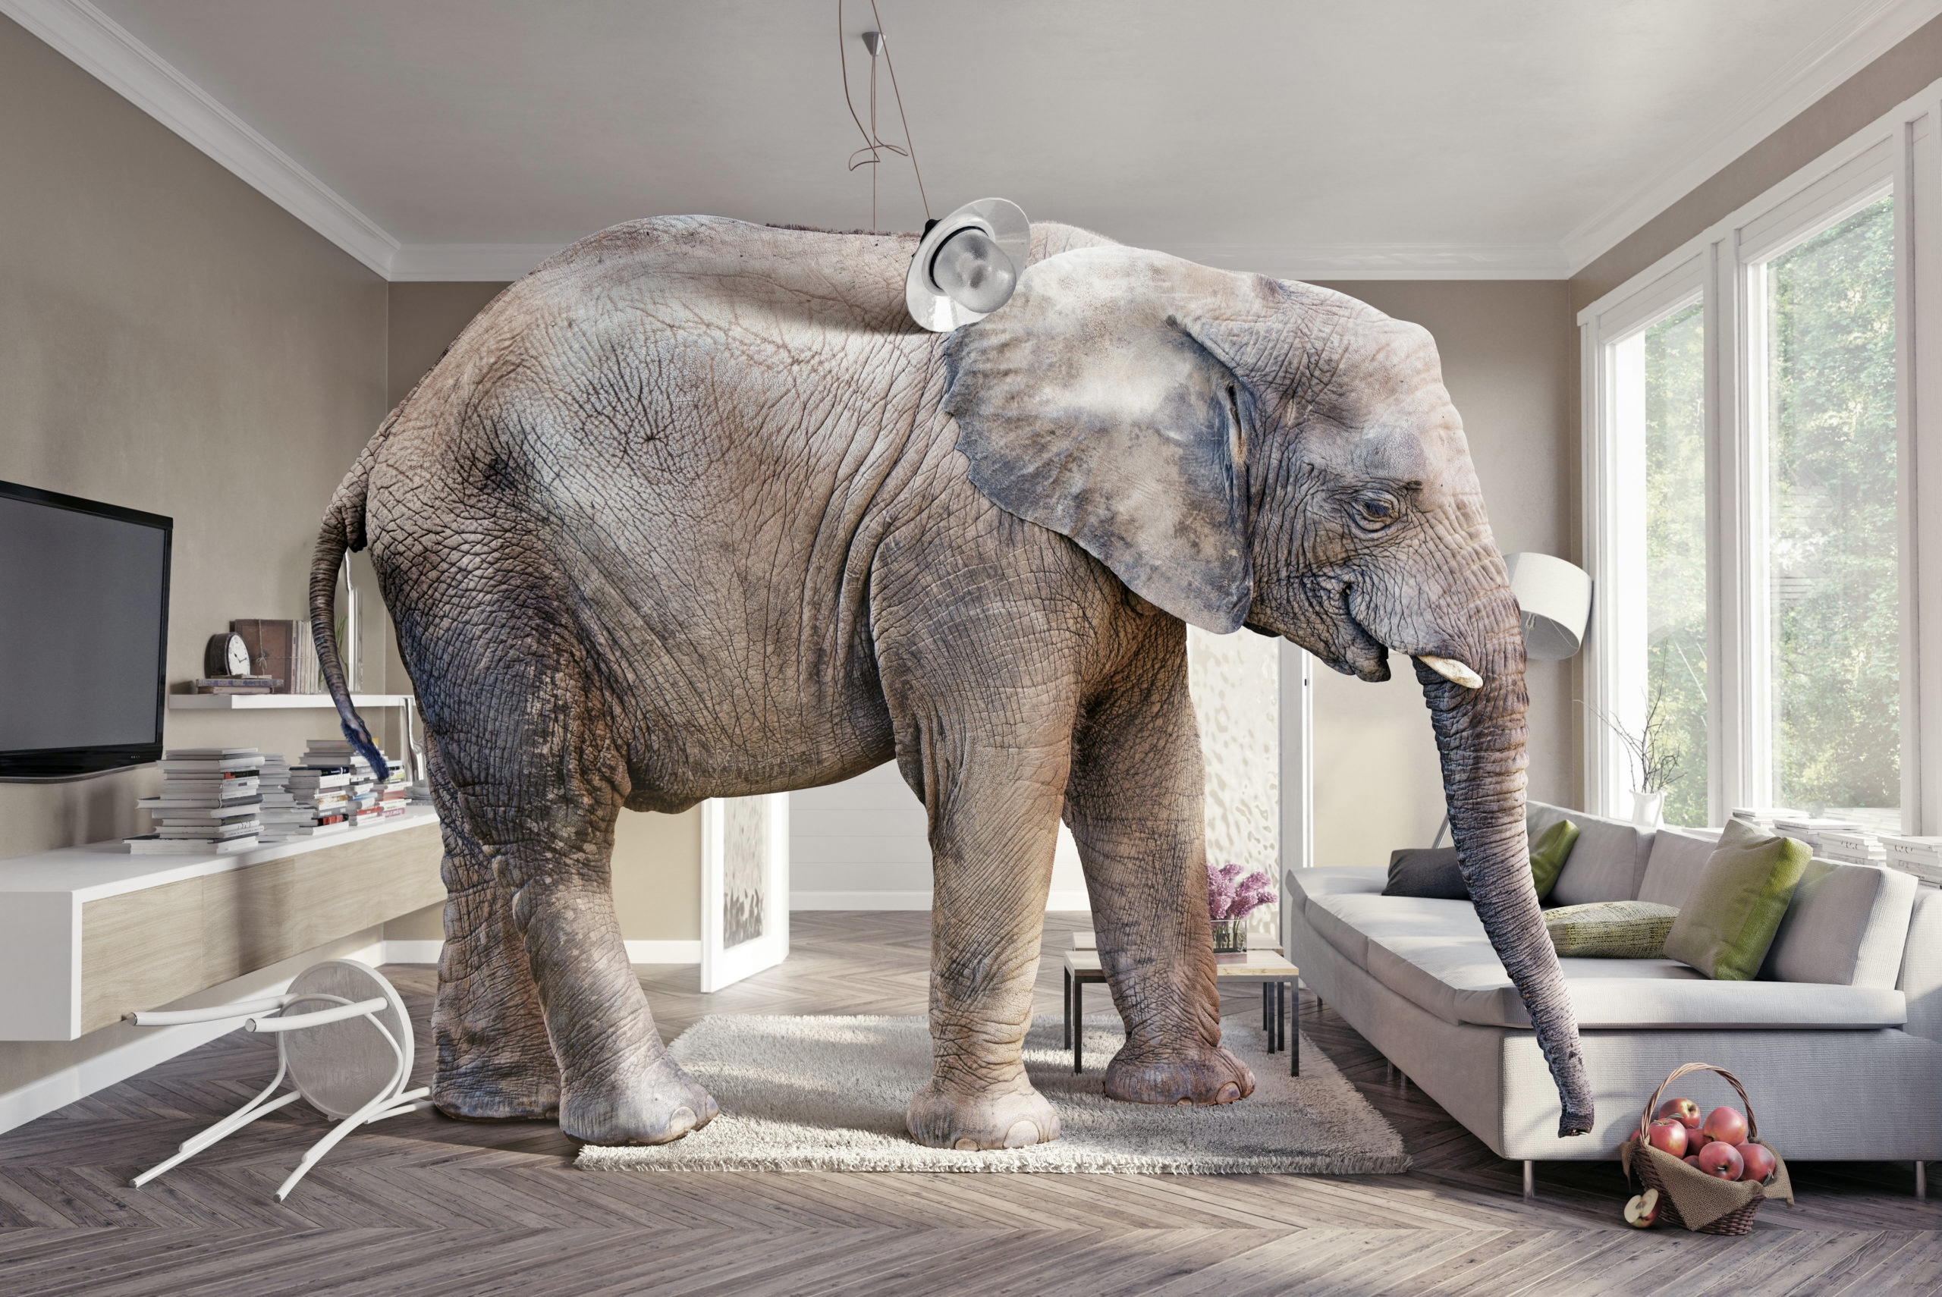
Elephant in the room

Slide 33
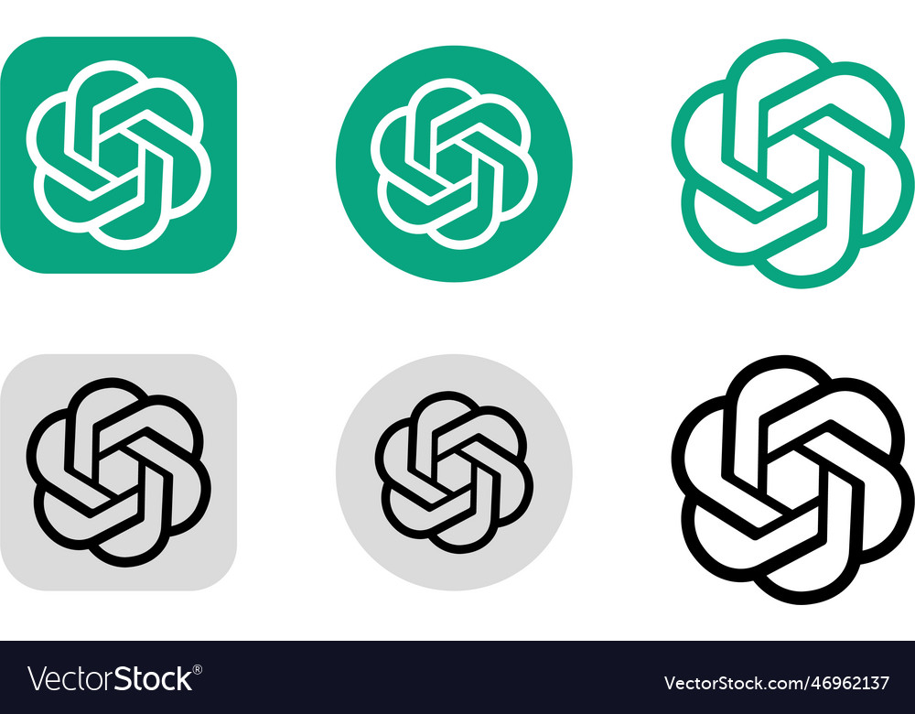
Elephant in the room
Notes:
And in general the Large Language Models.

Slide 34
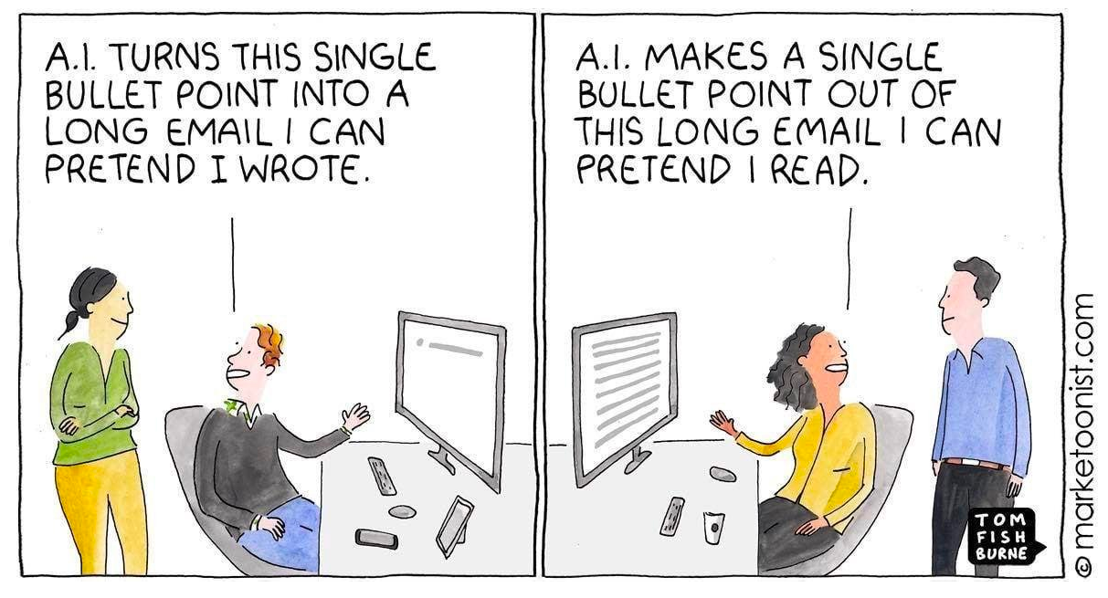
Chat GPT use case

Slide 35


Possible scenario

Slide 36

Possible scenario

Slide 37

Possible scenario

Slide 38

Possible scenario

Slide 39
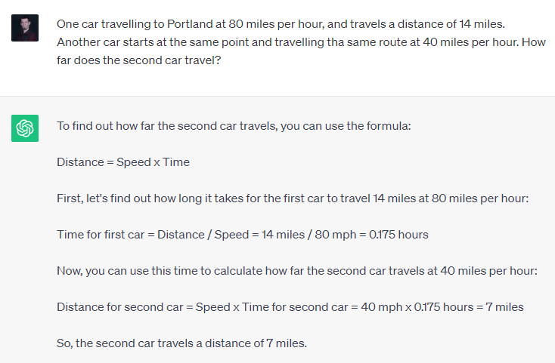
Chat GPT mistake
Notes:
Einstein riddle

Slide 40

Homework #2 (10 points)
Chat with Chat GPT or DeepSeek
Find a mistake and document it.
Link: https://chat.openai.com/auth/login

Slide 41
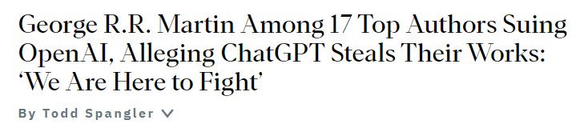
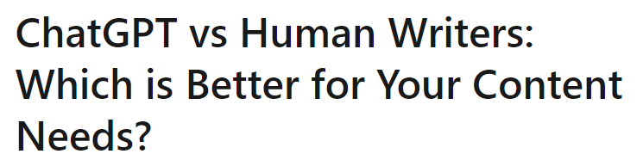
Different AI, same problem

Slide 42
3 rules of technology
1: When you invent a new technology, you uncover a new class of responsibilities
2: If the tech confers power, it starts a race
3: If you do not coordinate, the race ends in tragedy

Slide 43
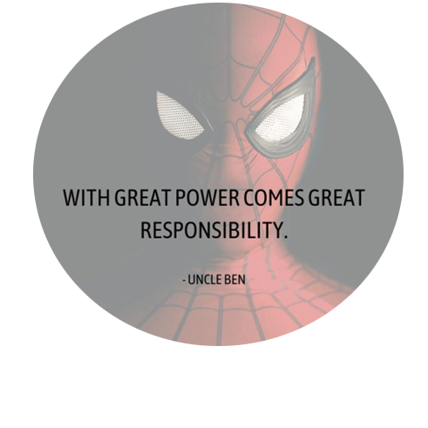

3 rules of technology
1: When you invent a new technology, you uncover a new class of responsibilities
2: If the tech confers power, it starts a race
3: If you do not coordinate, the race ends in tragedy

Slide 44

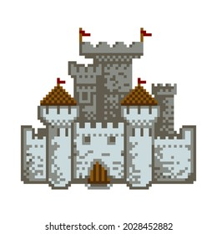
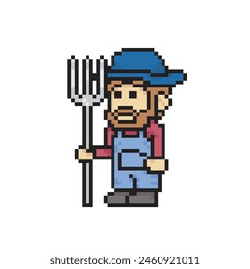
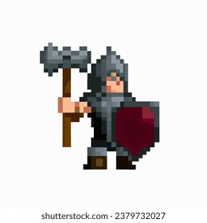
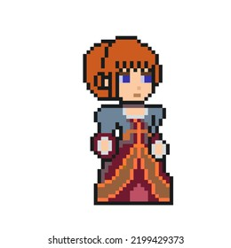
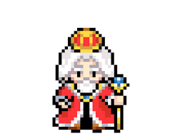

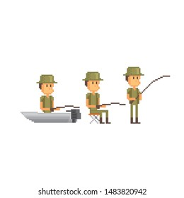
Just a Story

Slide 45

Just a Story

Slide 46

Just a Story

Slide 47
Just a Story

Slide 48

Just a Story

Slide 49

Just a Story

Slide 50

Just a Story

Slide 51
Just a Story

Slide 52
Just a Story

Slide 53
Just a Story – Who killed the Princess?

Slide 54
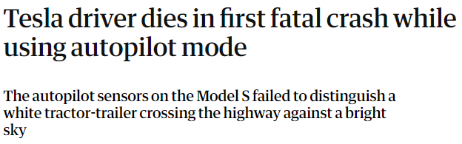
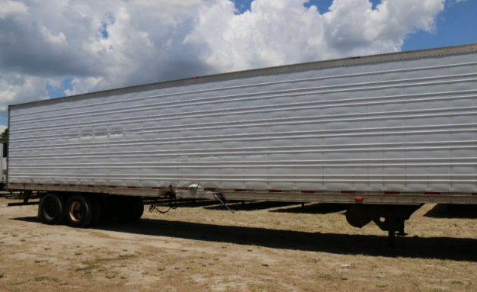
Similar story
Notes:
2016

Slide 55
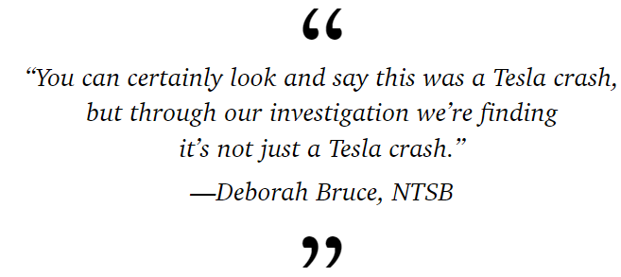
Similar story (2016)
Notes:
2016

Slide 56
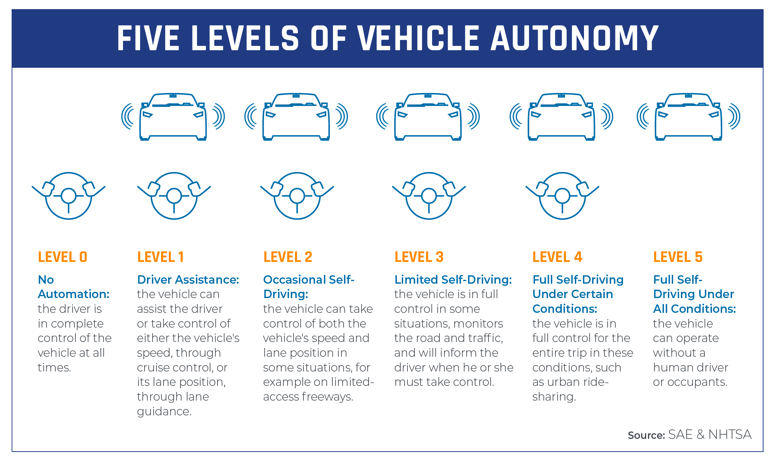

Slide 58




Social media
”Give everyone a voice”
”Connect with your friends”
”Join like-minded communities”

Slide 59
Social media
”Give everyone a voice”
”Connect with your friends”
”Join like-minded communities”
Is social media free?

Slide 60

Data driven word

Slide 61
Data driven word
”Dumdscrolling”
Recommender systems based on time.
Canceling a not wanted content takes more time – you will get more of it

Slide 62
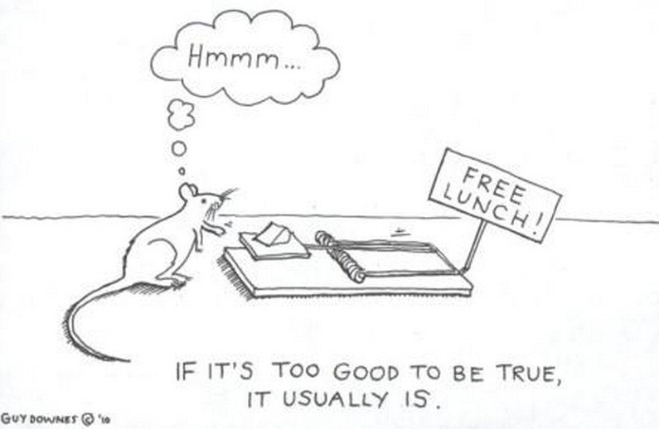
No free lunch
There is always a price.
If there is no price to pay, you are the price.

Slide 63
First contact with AI – Social media

Slide 64
First contact with AI – Social media
Information Overload
Addiction
Dumbscrolling
Influencer Culture
Sexualization
Shortened attention spans
Polarization
Bots, DeepFakes
Fake news

Slide 65

First contact with AI – Social media
Engagement maximalization
Information Overload
Addiction
Dumbscrolling
Influencer Culture
Sexualization
Shortened attention spans
Polarization
Bots, DeepFakes
Fake news

Slide 66
Engagement maximalization
Politics
Elections
Reaching
Customers
GDP
National security
Media and Journalism

Slide 67
Second contact with AI – Generative AI
AI fields before
Computer Vision
Speech recognition
Robotics
Music Generation
Speech Synthesis
Image generation

Slide 68
Second contact with AI – Generative AI
AI fields before
2017
Computer Vision
Speech recognition
Robotics
Music Generation
Speech Synthesis
Image generation
Transformer model

Slide 69
Second contact with AI – Generative AI
AI fields before
2017
AI fields after
Computer Vision
Speech recognition
Robotics
Music Generation
Speech Synthesis
Image generation
Language processing
Generative Large Language Multi-modal Modell
GLLMM
Transformer model

Slide 70
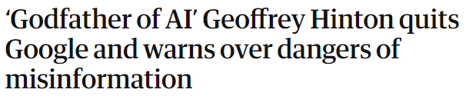
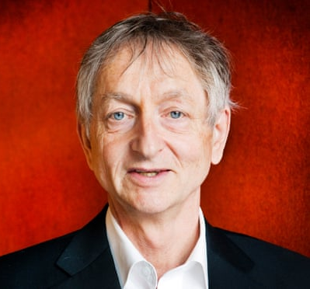
Godfather of AI (2023)
Dr. Geoffrey Hinton
“I console myself with the normal excuse: If I hadn’t done it, somebody else would have.”
Notes:
Warning sign
We are on uncharted therritory here.

Slide 71
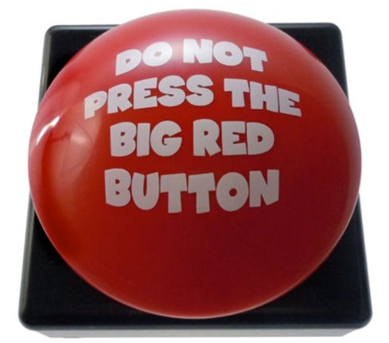
Godfather of AI
Dr. Geoffrey Hinton
“I console myself with the normal excuse: If I hadn’t done it, somebody else would have.”
Notes:
2023
Warning sign
We are on uncharted therritory here.

Slide 72
Thank you for your attention!

